Slide 1
COSC 6373: Computer Vision Spring 2023
Face Detection in Large Distance(FaDiLD)
Midterm Progress
Meng-Chen Lee, Jiechang Guo
Mentor: Dr. Christos Smailis
Department of Computer Science
University of Houston

Slide 2
Outline
Motivation
Problem
Related work
Methodology
Evaluation
Progress
Plan
Notes:
First, we will talk about the motivation of this project. Then, specify the difficulties of the task. Demonstrating some state-of-the-art works, and their methods. And how to evaluate the results. Last, showing our progress and future work.

Slide 3
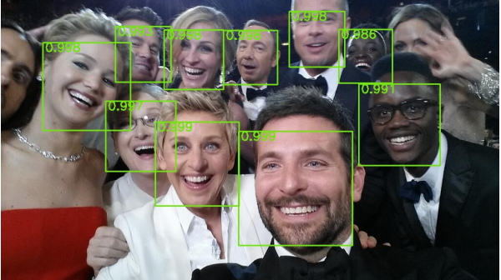
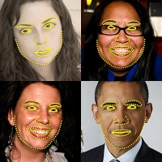

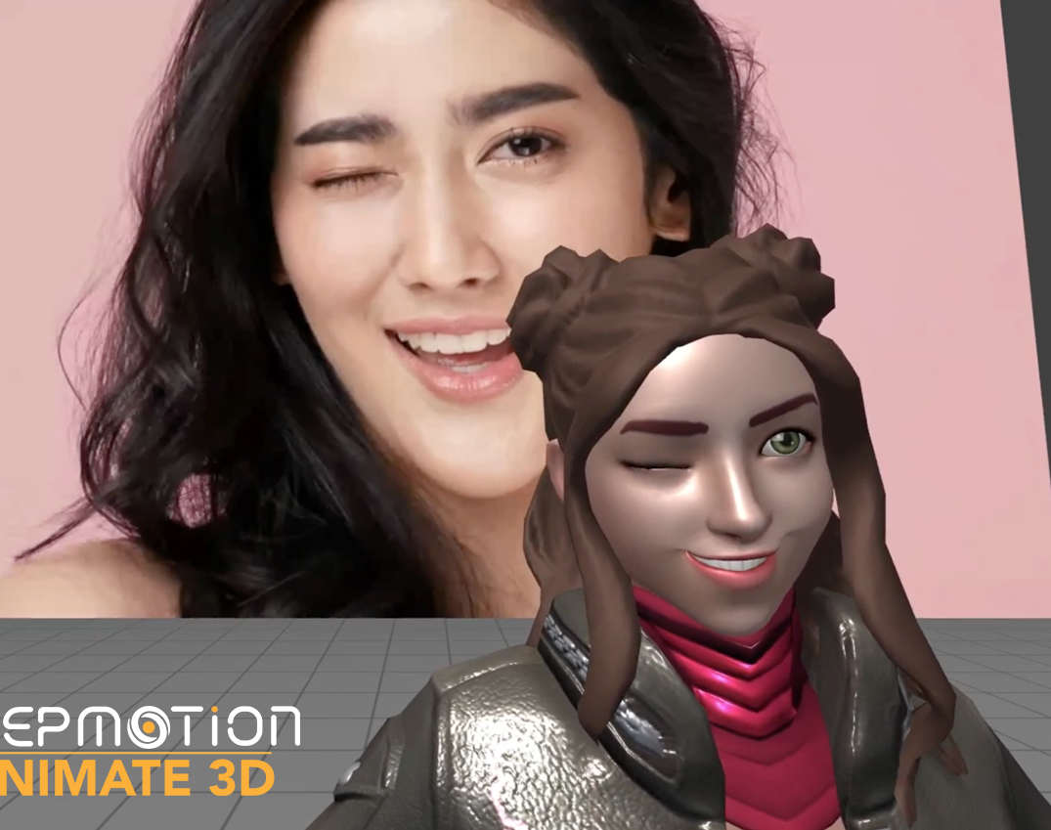
Motivation
Face Detection[1]
Face Landmark[4]
Face Recognition, Facial Expression[3]
Face Tracking[2]
[1] https://www.technologyreview.com/2015/02/16/169357/the-face-detection-algorithm-set-to-revolutionize-image-search/
[2] https://blog.deepmotion.com/2021/07/02/animate3d-facetracking/
[3] https://github.com/serengil/deepface
[4] https://docs.opencv.org/3.4/d2/d42/tutorial_face_landmark_detection_in_an_image.html
Notes:
Why is face detection so important?
Face detection is the first step for many face-related applications, such as face recognition, face tracking, facial expression recognition, facial landmarks detection and so on. Those technologies can achieve an overall better performance by faster and more accurate face detectors.
Other than that, face detection itself is also important, especially at long distances.
Like the need for surveillance and security applications. With the ability to detect faces at long distances, cameras and other surveillance systems can cover larger areas, leading to more effective monitoring and tracking of individuals. Face detection at long distances can also be used in other applications, such as tracking suspects in a high-speed chase or persons of interest in search and rescue operations. With the increasing use of surveillance cameras and other systems, the need for accurate and efficient face detection at long distances will likely continue to grow.

Slide 4
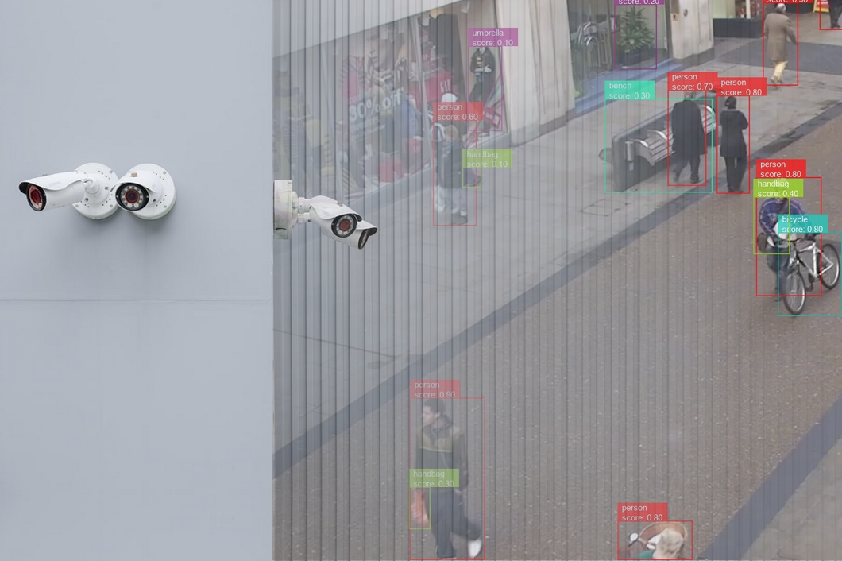
Motivation
https://viso.ai/wp-content/uploads/2022/06/computer-vision-surveillance-security-applications.png
Notes:
Other than that, face detection itself is also important, especially at long distances.
Like the need for surveillance and security applications. With the ability to detect faces at long distances, cameras and other surveillance systems can cover larger areas, leading to more effective monitoring and tracking of individuals.
Face detection at long distances can also be used in other applications, such as tracking suspects in a high-speed chase or persons of interest in search and rescue operations. With the increasing use of surveillance cameras and other systems, the need for accurate and efficient face detection at long distances will likely continue to grow.

Slide 5
Challenges of Face Detection in Large Distance
Low Resolution
Variations in illumination
Variations in pose and orientation
Occlusion
Background noise
Notes:
So, what are the difficulties of face detection, especially in large distances.
Low resolution: At larger distances, the size of the face in the image becomes smaller, leading to lower resolution. This makes it difficult to detect and recognize the facial features.
Variations in illumination: At large distances, the face may be subjected to different lighting conditions, such as shadows, glare, or reflections. These variations in illumination can affect the quality of the face image and make it difficult to detect the face.
Variations in pose and orientation: At larger distances, the face may appear at different poses and orientations, making it difficult to detect the face using traditional face detection methods.
Occlusion: At larger distances, the face may be partially or completely occluded by other objects, such as hats, glasses, or other people. This makes it difficult to detect the face in the image.
Background noise: At larger distances, the background noise in the image can interfere with the face detection process. This can be particularly challenging in crowded environments where there are multiple objects in the image.

Slide 6
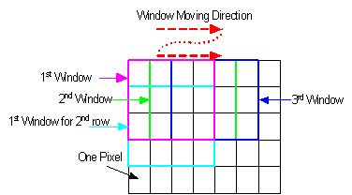
Core Techniques of Face Detection
Sliding windows
https://coe.northeastern.edu/Research/rcl/projects/SWO/swo.gif
Notes:
The sliding window technique involves dividing an image into a grid of fixed-size windows and applying a classifier or a neural network to each window to determine whether it contains an object of interest or not. The classifier or neural network may output a score or a probability indicating the likelihood of the presence of an object in each window.
One challenge with the sliding window technique is that it can be computationally expensive, especially when dealing with a large number of windows at different scales and aspect ratios. To address this challenge, techniques such as image pyramid and scale-space representation can be used to preprocess the image and reduce the number of windows to be evaluated.

Slide 7
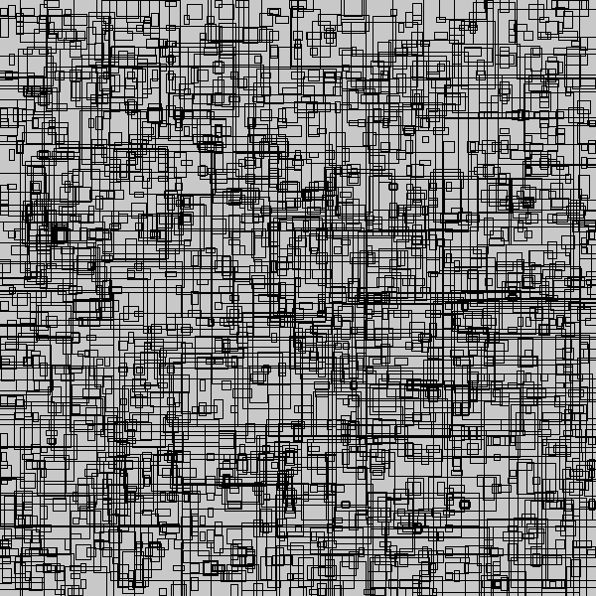
Core Techniques of Face Detection
Anchor boxes
https://miro.medium.com/v2/resize:fit:828/format:webp/1*SLKgjh8ikR0X4PeZlj3w0A.png
Notes:
Anchor boxes are a set of predefined bounding boxes with different aspect ratios and scales that are placed at various positions across the input image. During training, the algorithm learns to adjust the anchor boxes to better fit the ground truth bounding boxes of the faces in the image.
Non-maximum Suppression (NMS):
NMS is a common technique used to remove redundant bounding boxes and keep only the most accurate and representative detections. The process involves sorting the predicted bounding boxes by their confidence scores and selecting the one with the highest score as the first detection. Then, all other predicted bounding boxes that have an IoU overlap greater than a certain threshold (e.g., 0.5) with the selected detection are removed. This process is repeated until no more bounding boxes remain.
Object clustering:
Object clustering is a technique used to group bounding boxes that belong to the same object or instance. The process involves using clustering algorithms to group bounding boxes based on their location and appearance features. This technique can be useful when dealing with objects that are close to each other or partially occluded.

Slide 8
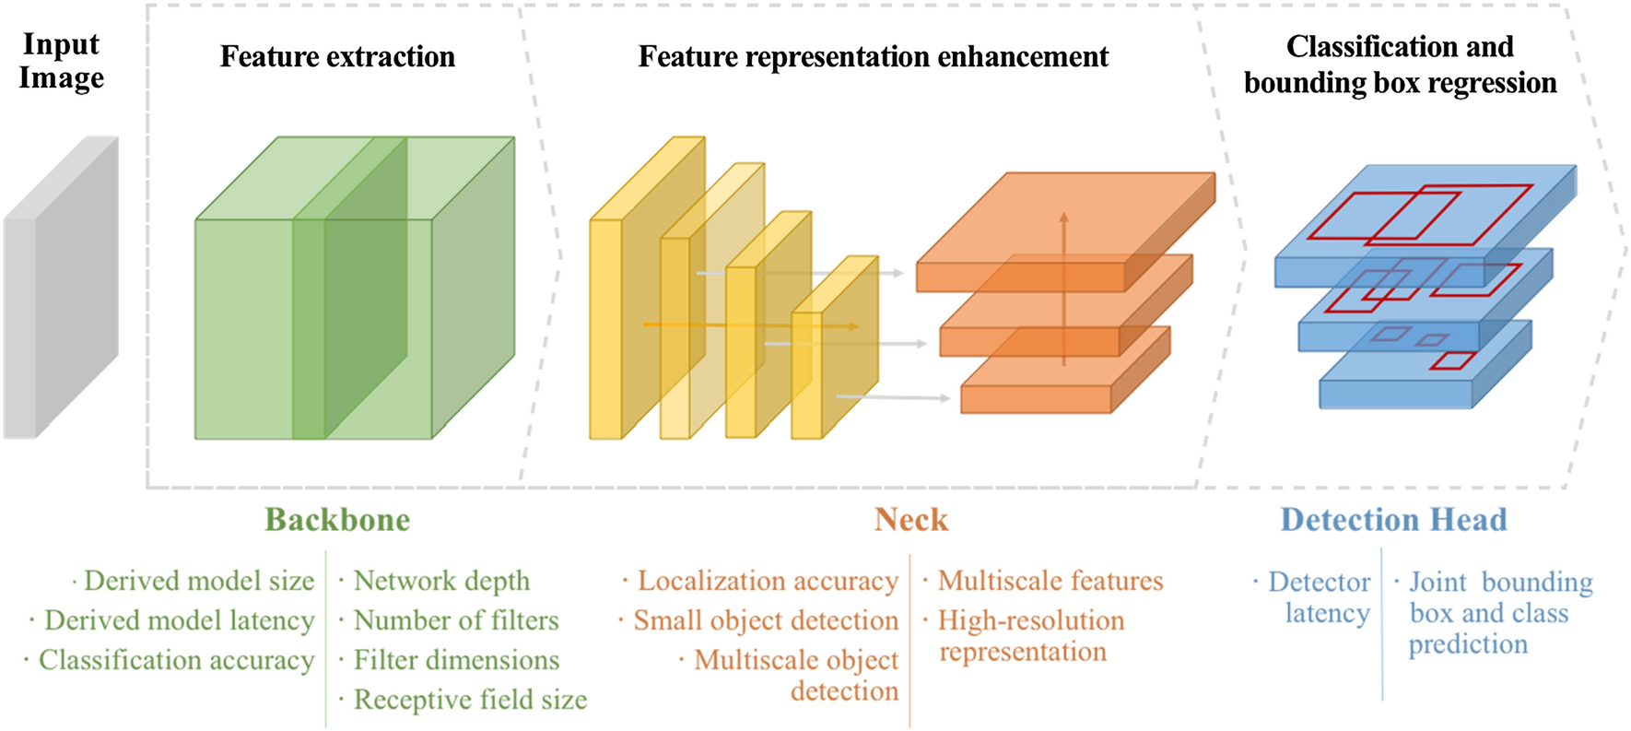
State-of-the-art Architecture
Optimized convolutional neural network architectures for efficient on-device vision-based object detection
Notes:
The backbone is used for feature extraction. It usually used a pretrained model to project the input images to feature maps.
The neck of the object detector refers to the additional layers existing between the backbone [1] and the head. Their role is to collect feature maps from different stages. The neck models are composed of several top-down paths and several bottom-up paths. The idea behind this feature aggregation existing in this model is to allow low-level features to interact more directly with high-level features, by mixing information from this high-level feature with the low-level feature.
Head is the last model of object detection, predicts bounding boxes and classes of objects

Slide 9
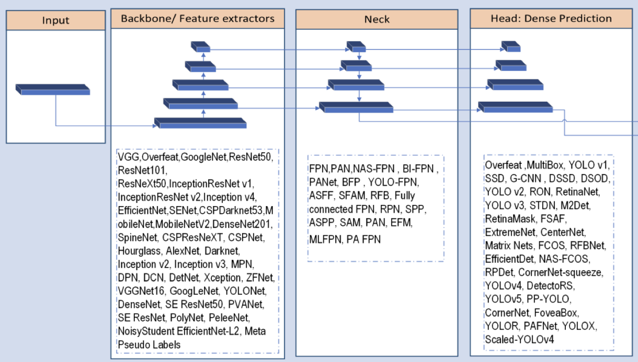
State-of-the-art Architecture
Deep Learning based Neck Models for Object Detection: A Review and a Benchmarking Study
Notes:
The neck of the object detector refers to the additional layers existing between the backbone [1] and the head. Their role is to collect feature maps from different stages. The neck models are composed of several top-down paths and several bottom-up paths. The idea behind this feature aggregation existing in this model is to allow low-level features to interact more directly with high-level features, by mixing information from this high-level feature with the low-level feature.

Slide 10
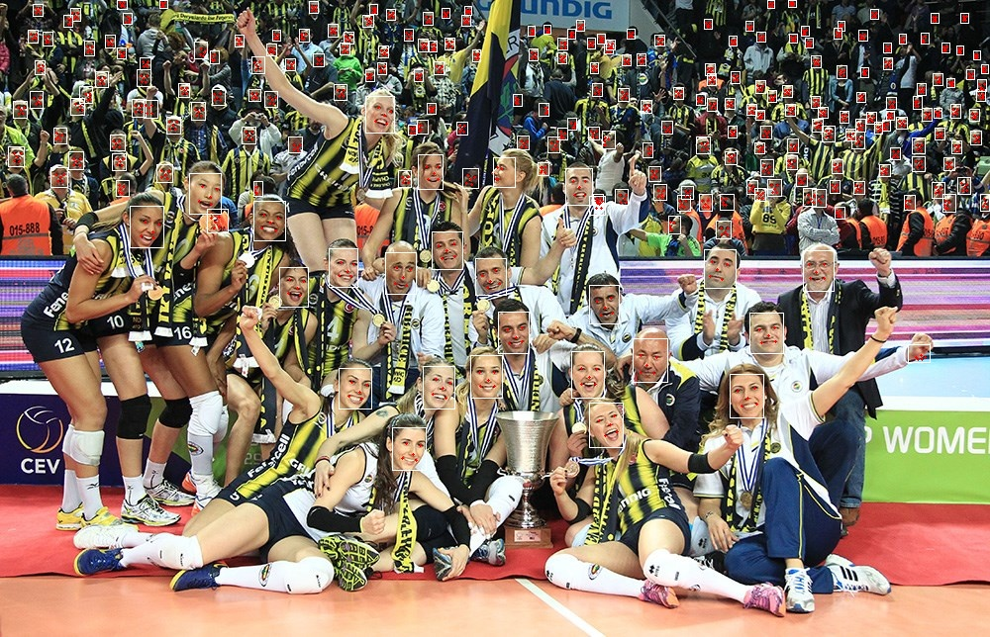
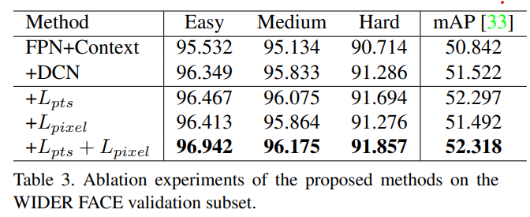
Related work - RetinaFace
Dataset:
WiderFace + Extra Annotation for landmarks
https://github.com/serengil/retinaface
Notes:
RetinaFace is a deep learning based cutting-edge facial detector for Python coming with facial landmarks. Its detection performance is amazing even in the crowd as shown in the following illustration.
Why is it good result? Compare with other

Slide 11
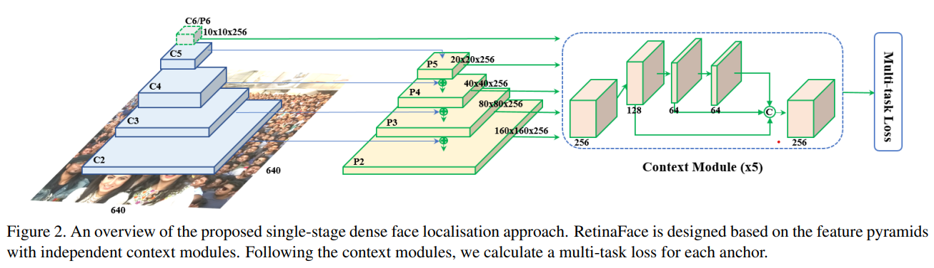
Related work – RetinaFace
RetinaFace: SingleStageDense Face Localisation in the Wild
Notes:
Retina also follows the backbone, neck, and head structure.
The backbone of RetinaFace is a modified ResNet-based feature extractor, which includes multiple convolutional layers and residual blocks to extract features from the input image.
The neck of RetinaFace includes a Feature Pyramid Network (FPN), which uses lateral connections to merge features from different layers of the backbone network and generates a set of feature maps at different scales. These feature maps are then used to generate proposals for the locations of faces in the input image.
The head of RetinaFace includes a set of classification and regression subnetworks, which predict the presence of faces and refine the location and size of the face bounding boxes. In addition, the head includes a landmark detection subnetwork, which predicts the coordinates of facial landmarks such as the eyes, nose, and mouth.

Slide 12
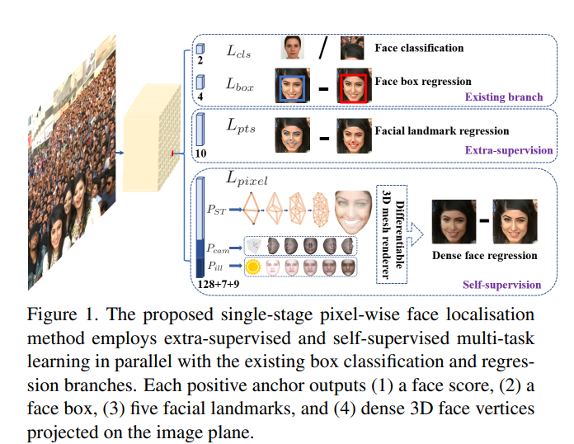
Related work – RetinaFace
RetinaFace: SingleStageDense Face Localisation in the Wild
Notes:
RetinaFace is a deep learning based cutting-edge facial detector for Python coming with facial landmarks. Its detection performance is amazing even in the crowd as shown in the following illustration.

Slide 13
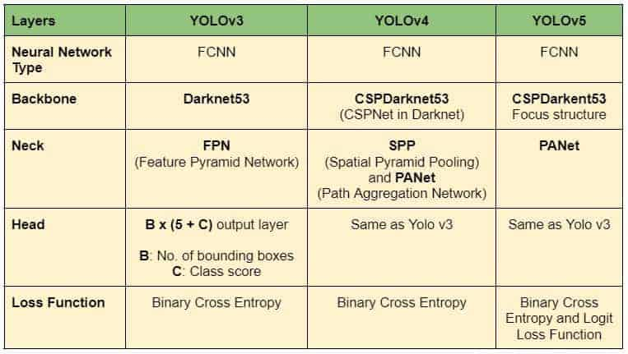
Related work – YOLO (You Only Look Once)
https://github.com/derronqi/yolov7-face
Notes:
Why is Yolo called You Only Look Once? This is because YOLO predicts all the objects within an image in ONE forward pass.
Bottom-up Path Augmentation:
2. Adaptive Feature Pooling:
3. Fully-Connected Fusion:

Slide 14
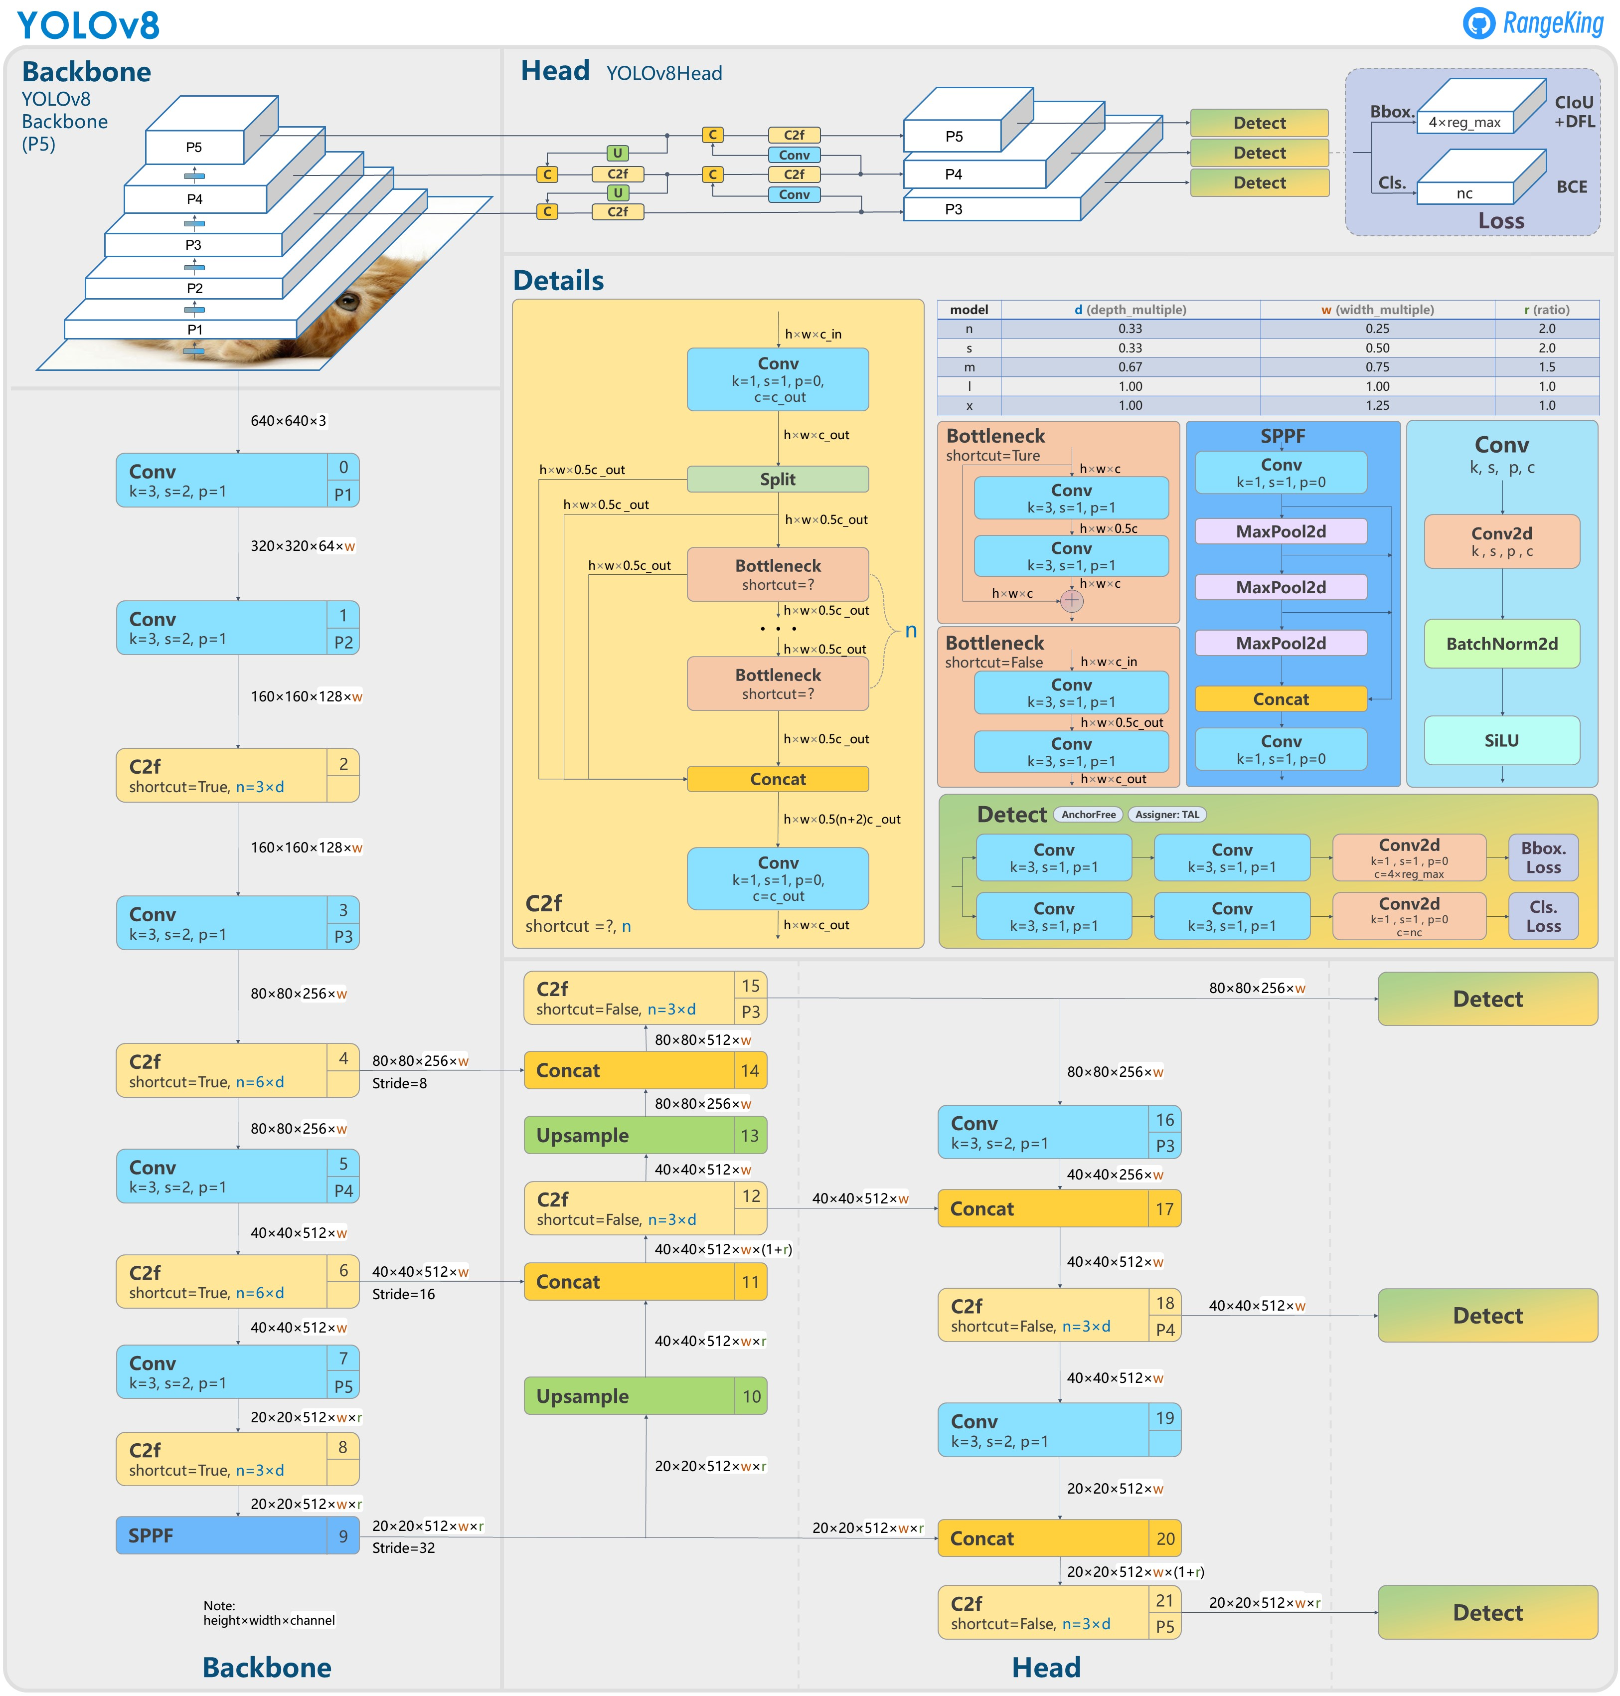
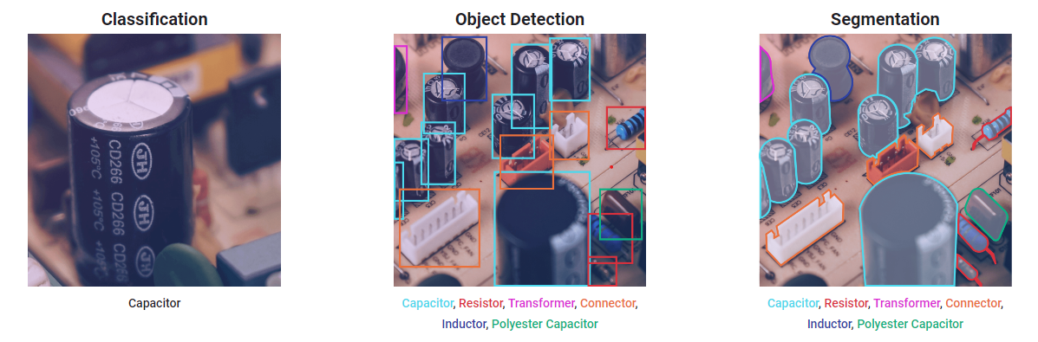
Related work – YOLOv8
Anchor-free detection
https://ultralytics.com/yolov8
Notes:
Ultralytics YOLOv8, developed by Ultralytics, is a cutting-edge, state-of-the-art (SOTA) model that builds upon the success of previous YOLO versions and introduces new features and improvements to further boost performance and flexibility. YOLOv8 is designed to be fast, accurate, and easy to use, making it an excellent choice for a wide range of object detection, image segmentation and image classification tasks.
The paper of v8 isn’t released yet, so I’m not sure about the mechanism of anchor-free detection.

Slide 15
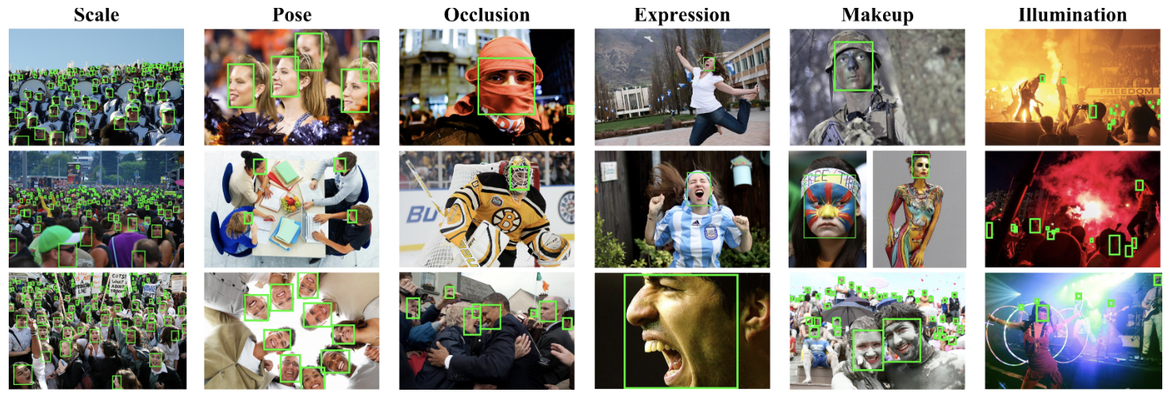
Data– WIDER FACE
32,203 images | 393,703 faces | 60 events
Train: 12,880 (40%)
Validation: 3,226 (10%)
Test: 16,097​ (50%) no ground truth
Easy: 41-60 event classes
Medium: 21-40 event classes
Hard:1-20 event classes
http://shuoyang1213.me/WIDERFACE/
Notes:
Let me introduce the dataset. We will use the wider face which is the benchmark dataset for the task of face detection.
It includes more than 32 thousand images and labels more than 390 thousand faces in 60 different events covering a large number of scenes in the real world.
The dataset randomly splits into 40% of train data, 10% of validation data, and 50% of test data, however, the test data comes with no ground truth.
Based on the detection rate, the events are divided into easy, medium, and hard which can help the evaluation process.

Slide 16
Data– WIDER FACE
Bounding box | x1,y1,w,h
Blur | clean(0), normal blur(1), heavy blur(2)
Expression | typical expression(0), exaggerate expression(1)
Illumination | extreme(0), occlusion(1)
Invalid | false(0), true(1)
Occlusion | no occlusion(0), partial occlusion(1), heavy occlusion(2)
Pose | typical pose(0), atypical pose(1)
http://shuoyang1213.me/WIDERFACE/
Notes:
The faces come with a high degree of variability. The label for each image includes bounding boxes that indicate the position of the face and other attributes like blur, expression, illumination, validation, occlusion, and pose.

Slide 17
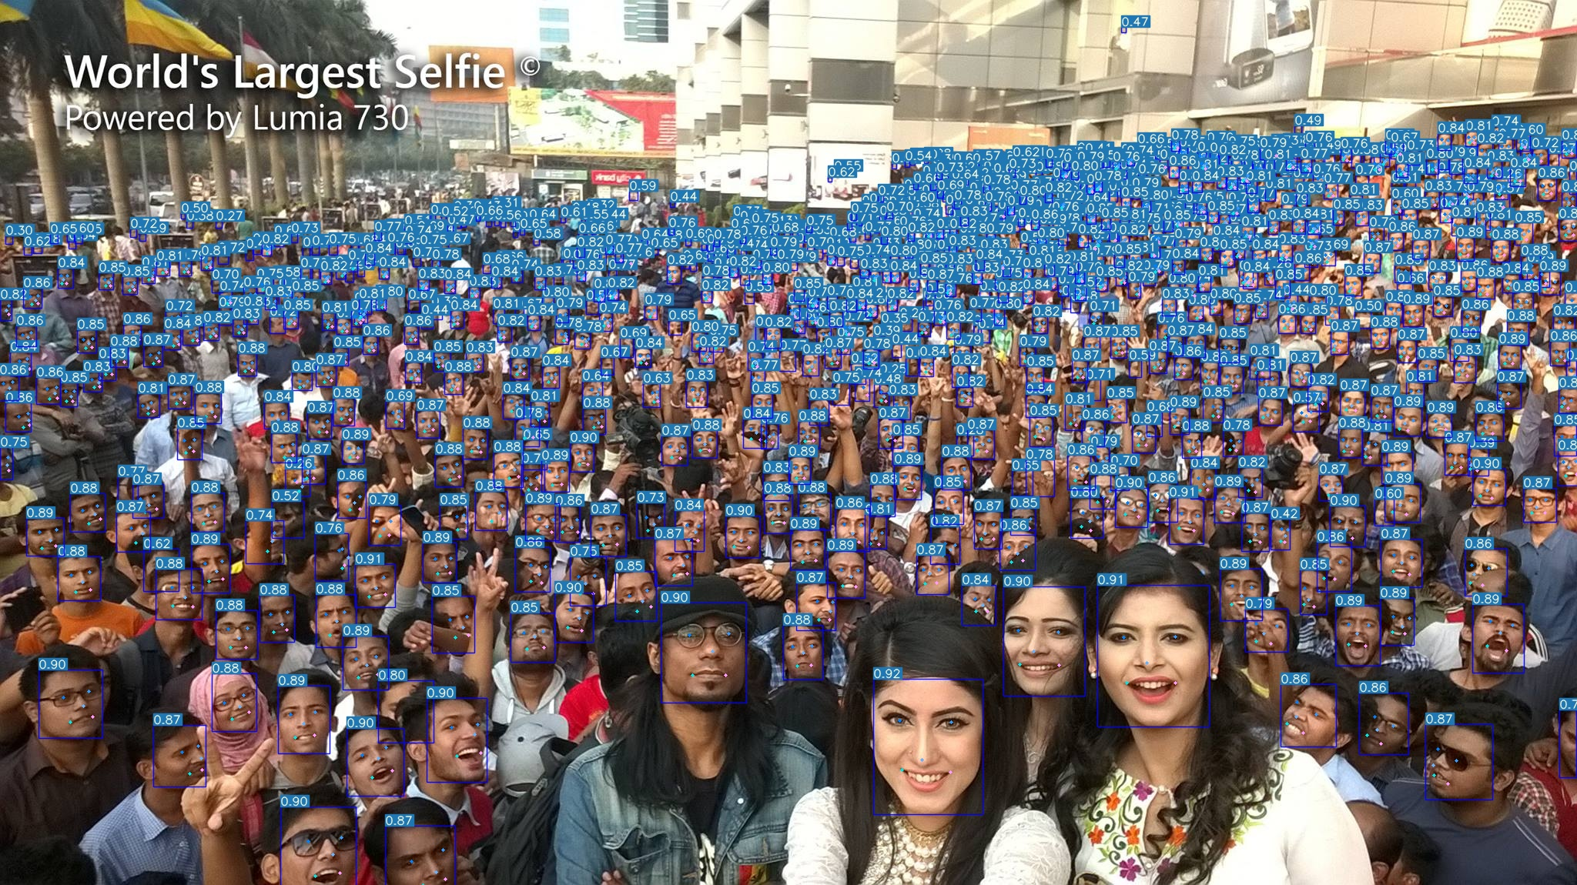
Baseline – YOLOv7 Face
Method | Test Size | Easy | Medium | Hard | FLOPs (B) @640
yolov7-lite-t | 640 | 88.7 | 85.2 | 71.5 | 0.8
yolov7-lite-s | 640 | 92.7 | 89.9 | 78.5 | 3.0
yolov7-tiny | 640 | 94.7 | 92.6 | 82.1 | 13.2
yolov7s | 640 | 94.8 | 93.1 | 85.2 | 16.8
yolov7 | 640 | 96.9 | 95.5 | 88.0 | 103.4
yolov7+TTA | 640 | 97.2 | 95.8 | 87.7 | 103.4
Dataset: WiderFace, yolov7-face-label
https://github.com/derronqi/yolov7-face
Notes:
The baseline of our project is YOLOv7 Face, they adapted YOLO version 7 to do face detection. The model was trained on WiderFace and yolov7-face-label data.
They got pretty good results on the easy and medium tasks and fair results on the hard task.

Slide 18
Methodology
Baseline evaluation
Evaluate YOLOv7-Face on WilderFace validation data
Tentative architecture modification
1. Change the backbone model (transformer)
2. Apply super-resolution on the data with normal/heavy blur
Evaluation
Evaluate on validation data
Submit test prediction files
Notes:
We will evaluate the performance of YOLOv7Face on Wilder Face validation data.
And we came up with two possible architectural modifications.
The first tentative modification is changing the backbone model to a state-of-the-art model like a transformer model. Because we believe that these advanced models may have a better ability for feature extraction.
As mengchen mentioned before, one challenge of face detection in large distance is the low resolution, thus we decided to apply a super-resolution diffusion model to the image labeled as heavy blur before we do face detection. By converting the low-resolution image to a higher resolution, our model may learn more.

Slide 19
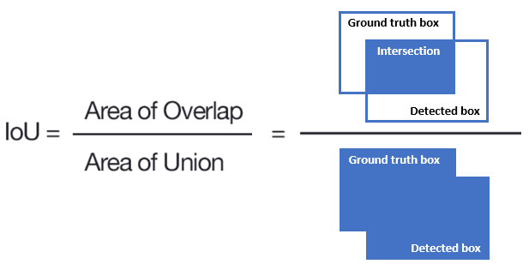
Evaluation
Intersection over Union (IoU) : accuracy of the detection
https://www.baeldung.com/cs/object-detection-intersection-vs-union
Notes:
The typical evaluation metric for the task of face detection is Intersection over Union, the IoU is the metric to evaluate the accuracy of the detection, Given a ground-truth bounding box and a detected bounding box, we compute the IoU as the ratio of the overlap and union areas:

Slide 20
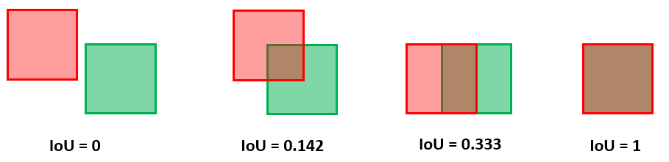
Evaluation
https://www.baeldung.com/cs/object-detection-intersection-vs-union
Notes:
Here are some examples of IoU.
The IoU can have any value between 0 and 1. If two boxes do not intersect, the IoU is 0. On the other hand, if they completely overlap, the IoU is 1.
Therefore, the higher the IoU, the better the prediction of a face detection system.

Slide 21
Evaluation
False Positive
True Positive
https://www.baeldung.com/cs/object-detection-intersection-vs-union
Notes:
The threshold of IoU is usually set to 0.5.
If the IoU score is above the threshold, the detection is considered a true positive.
If the score is below the threshold, the detection is considered a false positive.

Slide 22
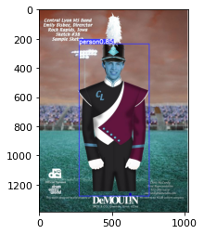

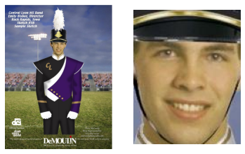
Progress
Downloaded Dataset
Ran RetinaFace detection and extraction
Ran YOLOv8 object detection
Ran YOLOv7-Face face detection
Tested Super-resolution
RetinaFace
YOLOv8
YOLOv7 Face
Notes:
The progress we get so far are
We downloaded the dataset and understand it.
And we played around with the related model including RetinaFace, YOLOv8, and YOLOv7-Face to do face detection and object detection. The left is the face extraction result of retina, the middle is the object detection result of the YOLOv8, and the right is the result of YOLOv7-Face.

Slide 23
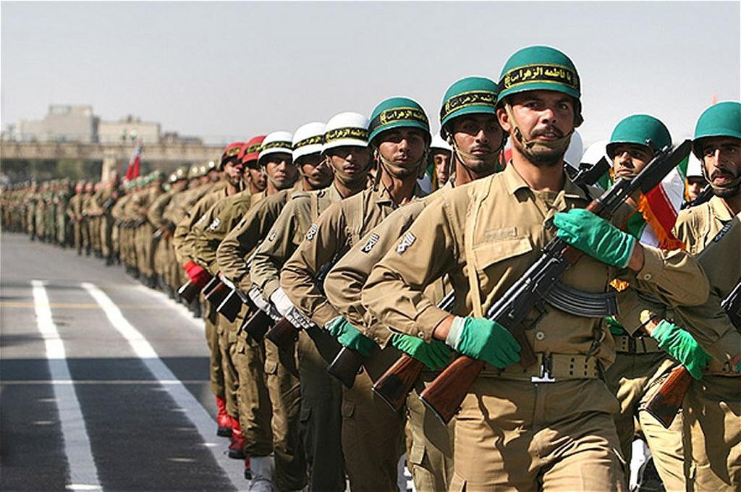

Progress
Super-resolution result. left: original right: result
Notes:
We also tried the super-resolution diffusion model to test how it improves the quality of the image.
The left image is the original image, and the right image is after applying super-resolution. We can tell that there is an observable improvement on the face of the soldiers.
We hope this process can help improve the performance of our model.

Slide 24

Plan
Notes:
Here is our plan, after the midterm presentation, we will first do a baseline evaluation before March 6 and
Take most of our time working on the architecture modification, including fine-tuning on the wilder face before April 3.
And finish the evaluation, before April 17. Then work on the report and presentation for the final submission.

Slide 25
Reference
[1] A. Bochkovskiy, Chien-Yao Wang, Hong-Yuan Mark Liao., “YOLOv5: An Improved Real-Time Object Detection System”. arXiv preprint arXiv:2012.03803. 2020.,https://github.com/ultralytics/yolov5
[2] Zhi Zhang, Shifeng Zhang, Xiaobo Wang, Peihua Li, and Jian Sun “RetinaFace: SingleStageDense Face Localisation in the Wild”, arXiv preprint arXiv:1905.00641. 2019
[3] Shuo Yang, Ping Luo, Chen Change Loy, and Xiaoou Tang, “WIDER FACE: A Face Detection Benchmark.” in Proc. Conference on Computer Vision and Pattern Recognition, 2016
[4] https://ai.googleblog.com/2021/07/high-fidelity-image-generation-using.html.
Notes:
Look at the errors

Slide 26
Thanks for your listening!

